Slide 1

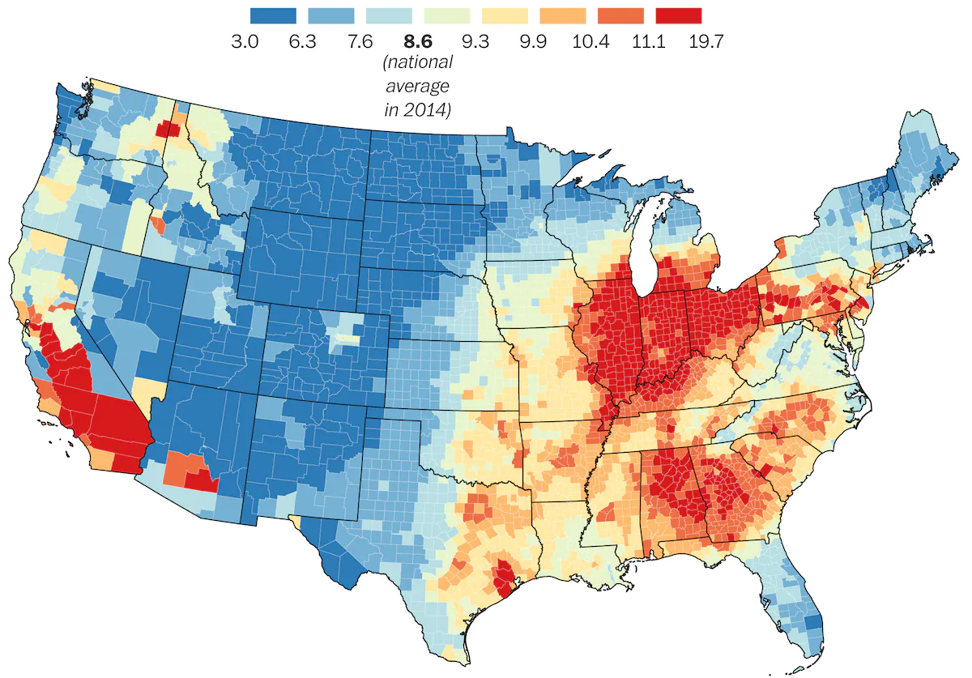
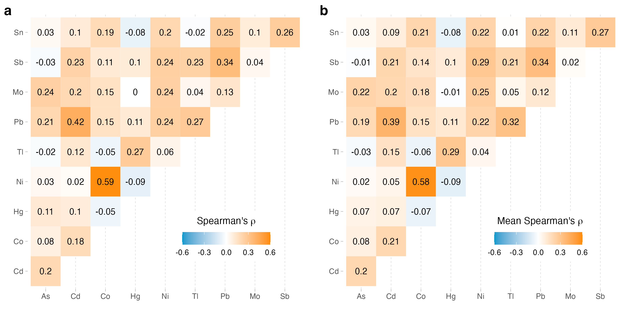
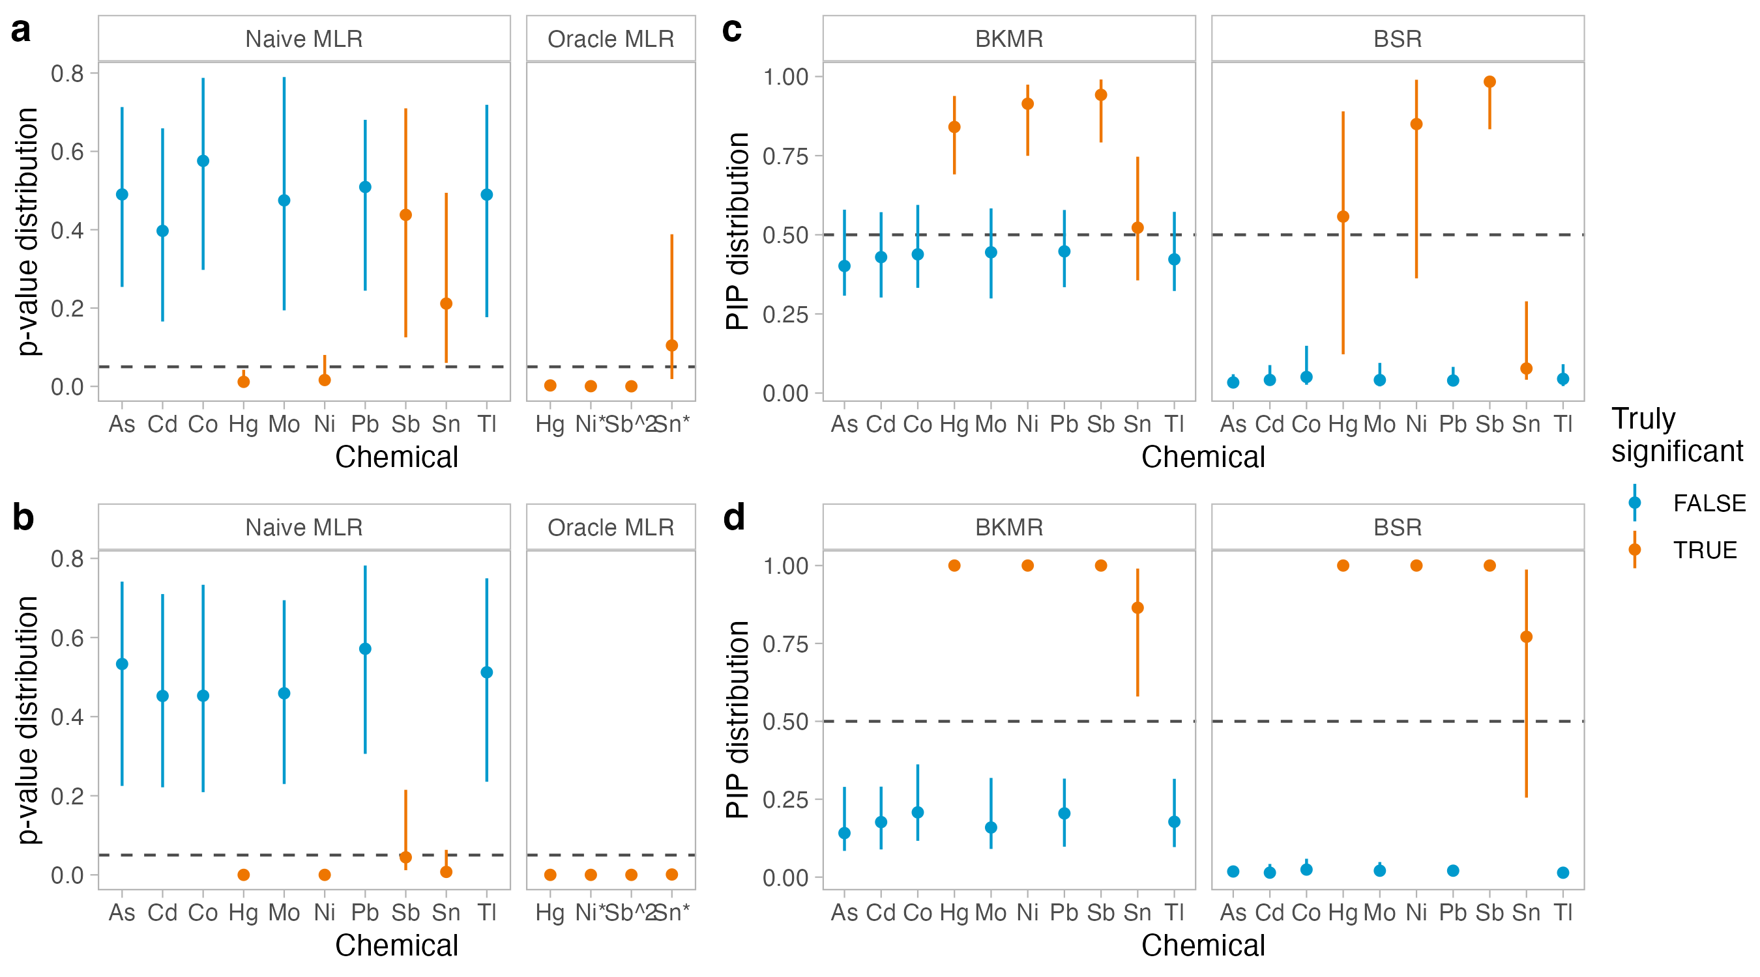
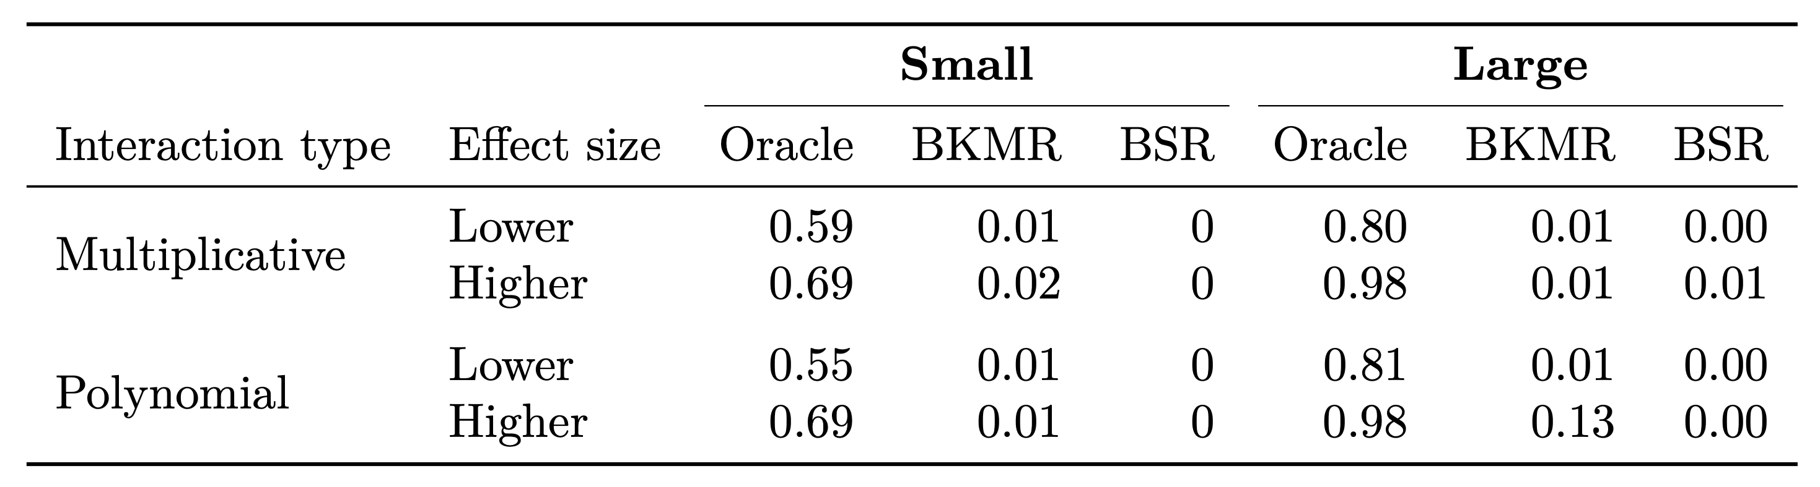
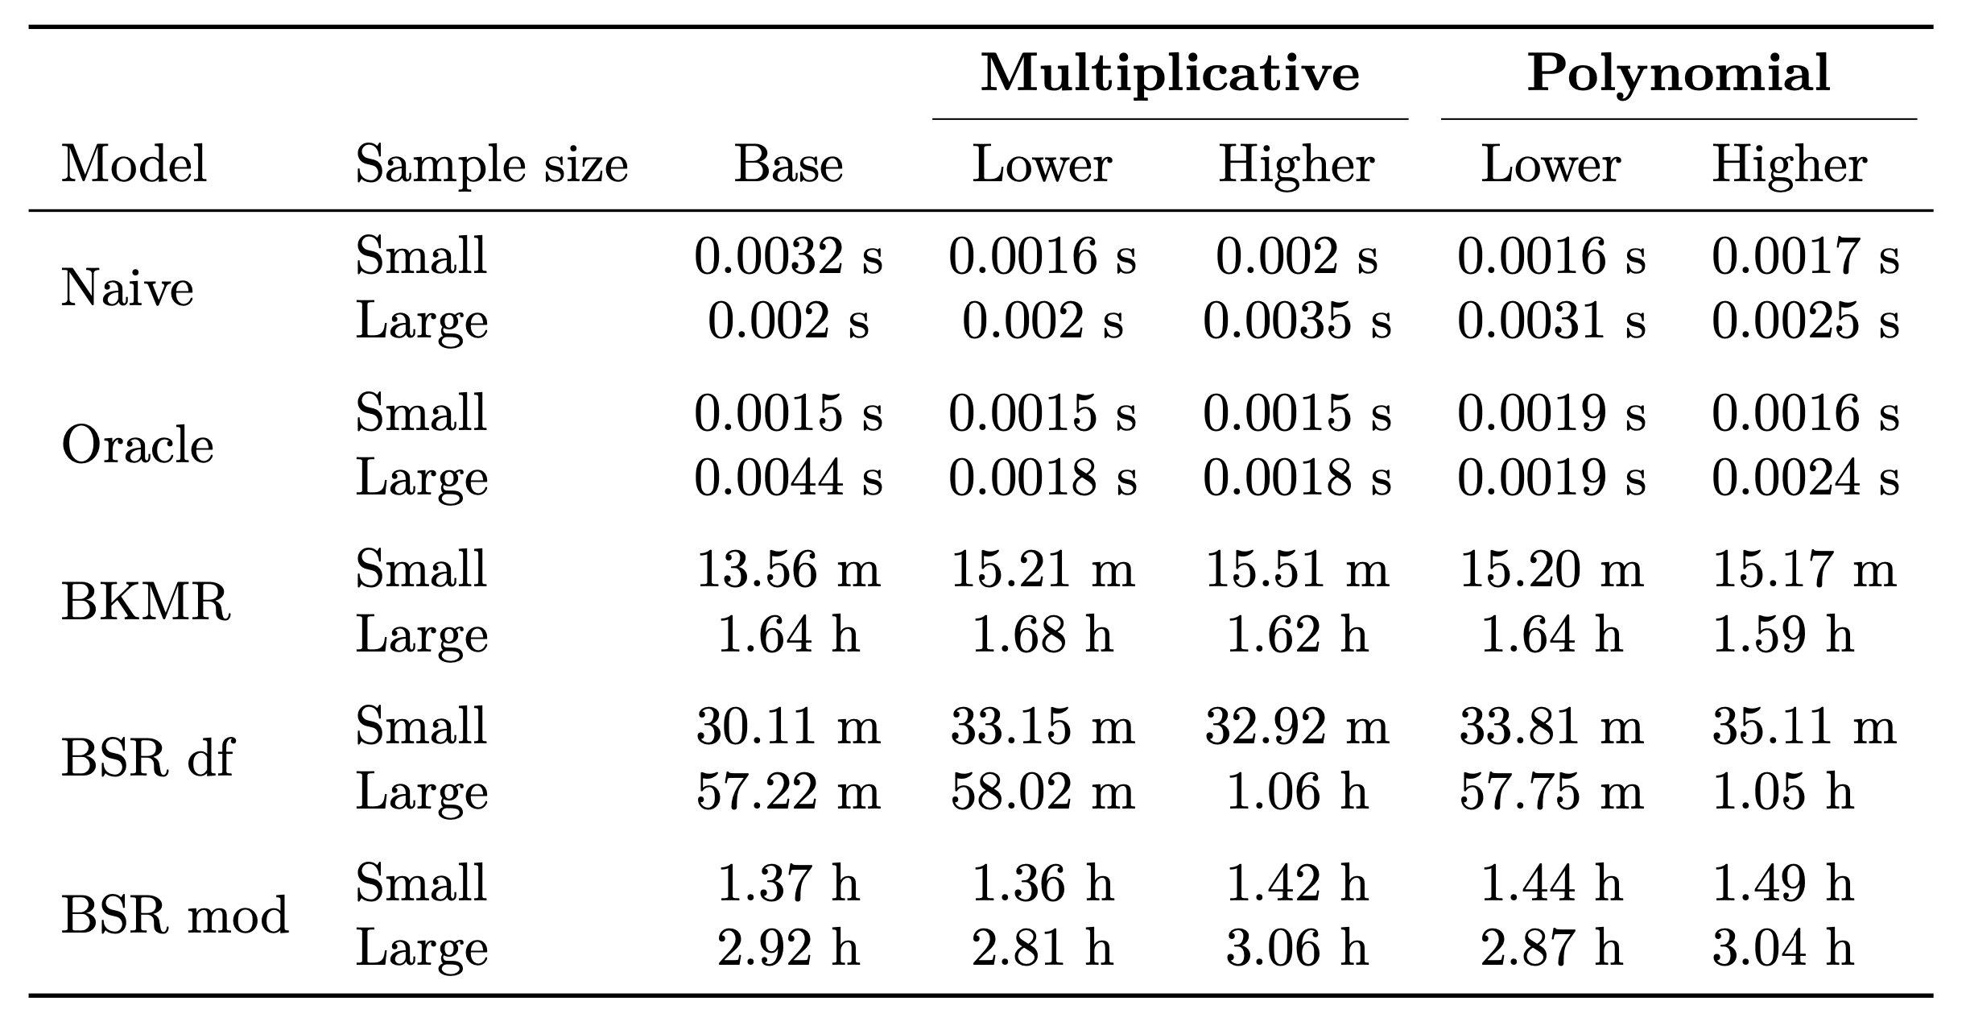
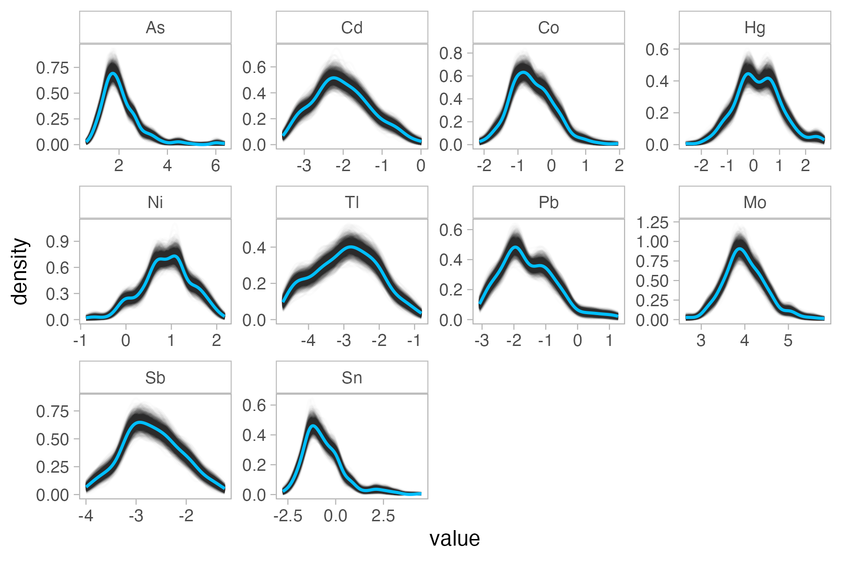
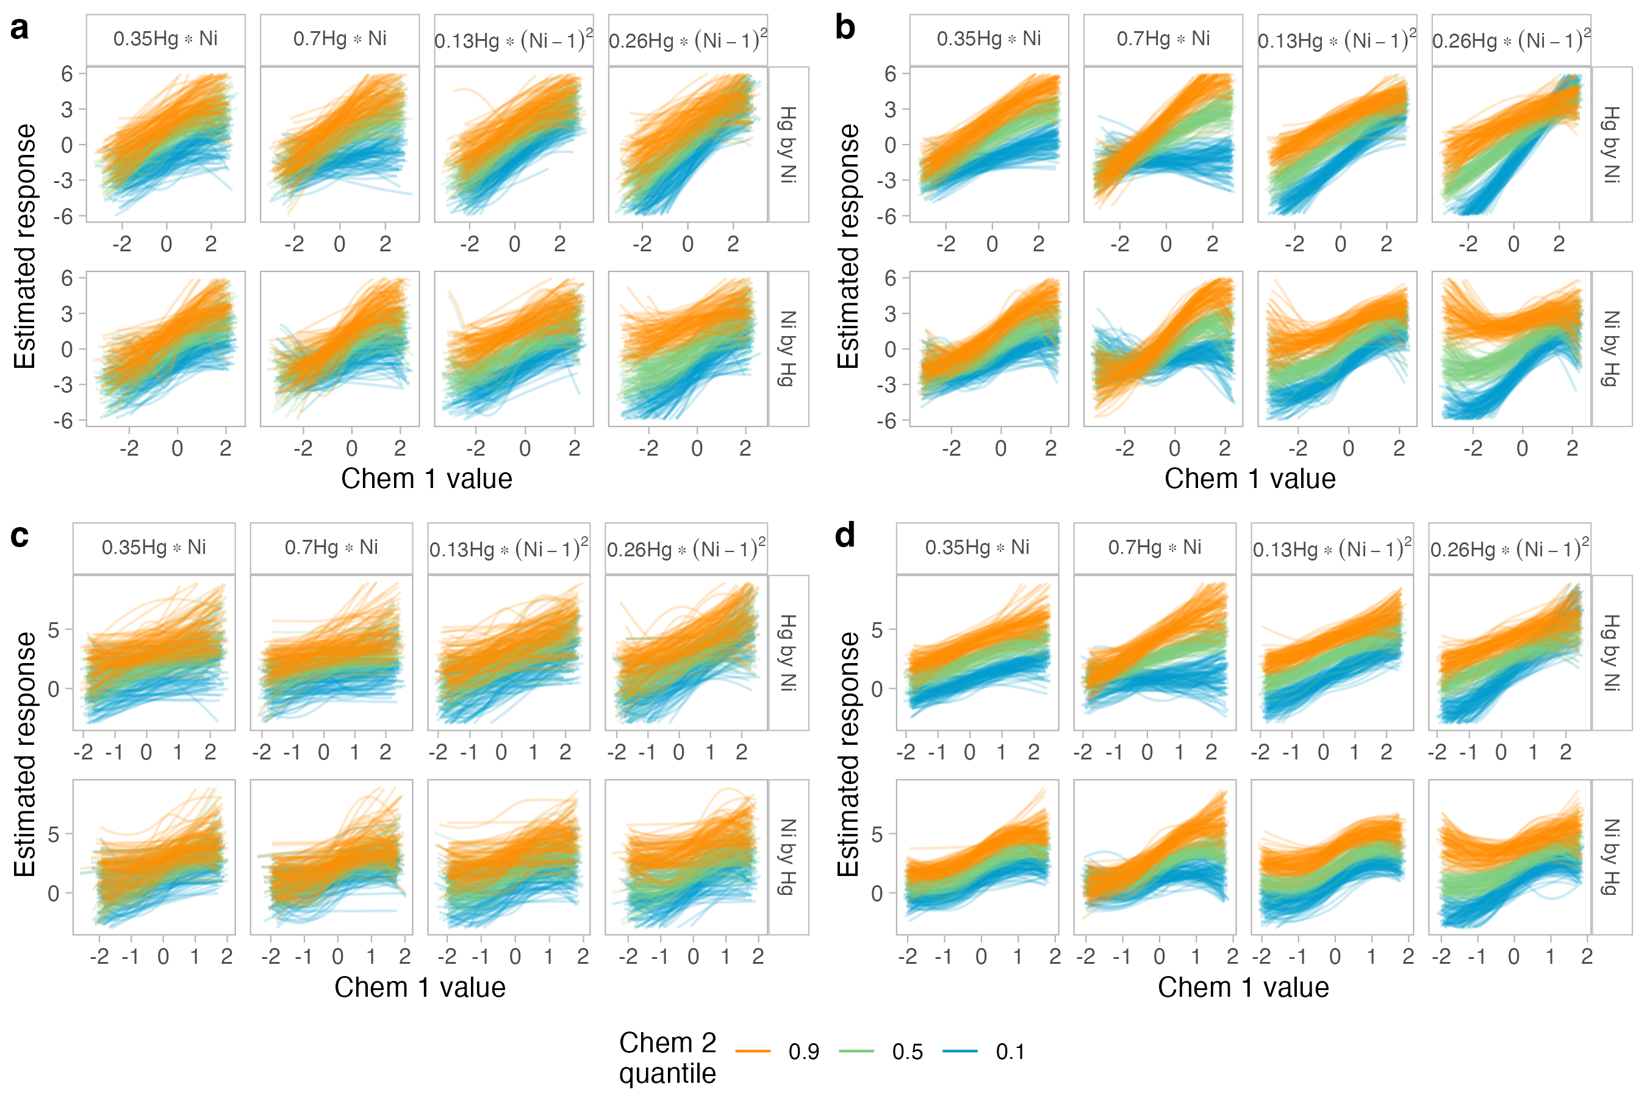
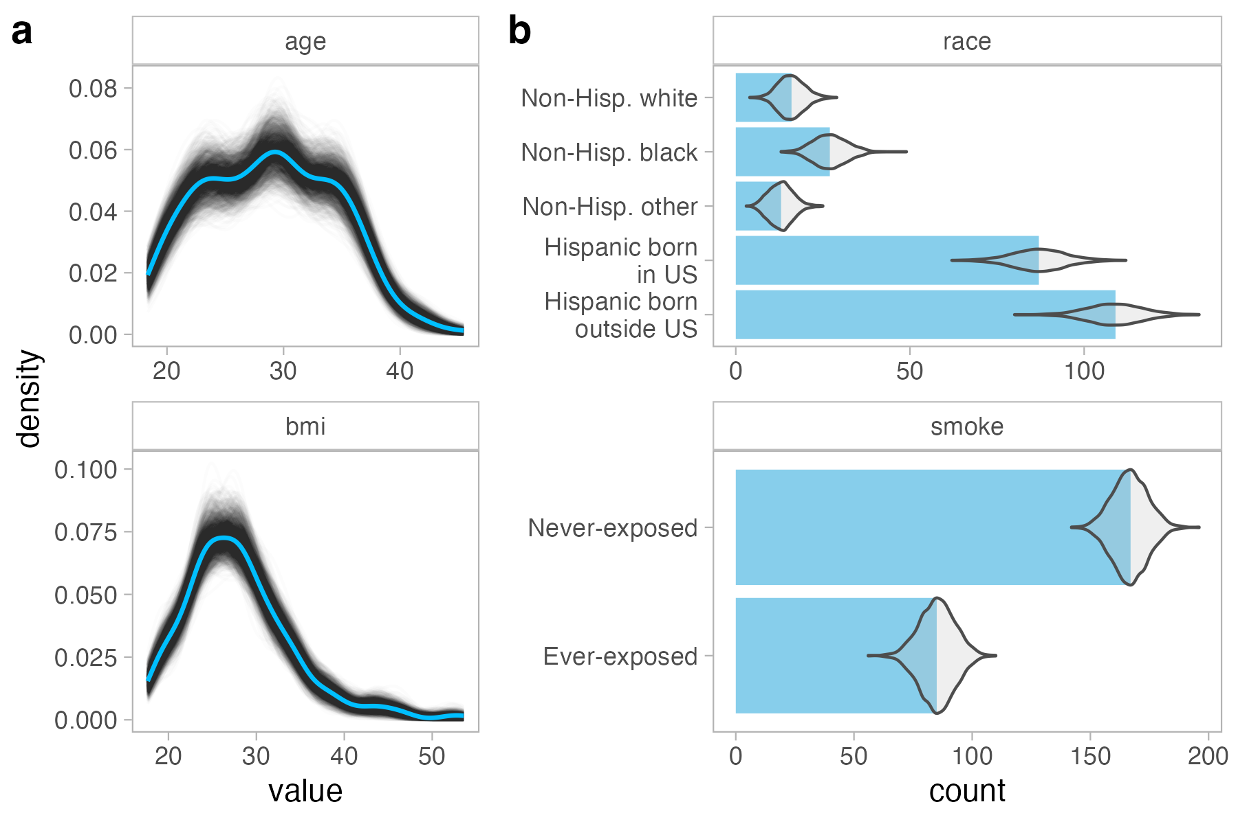
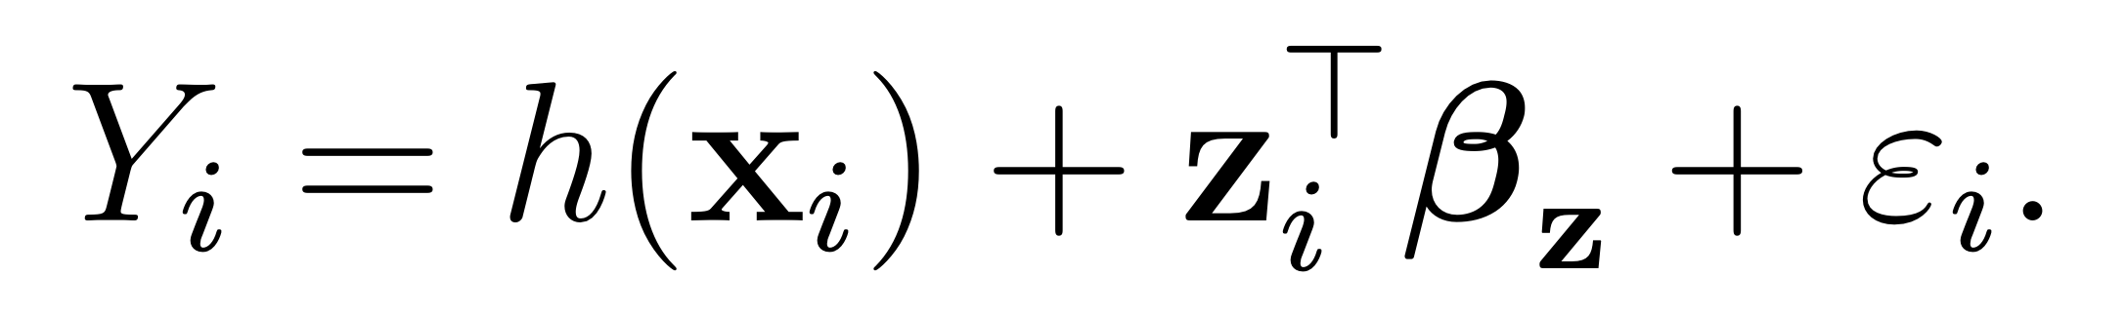
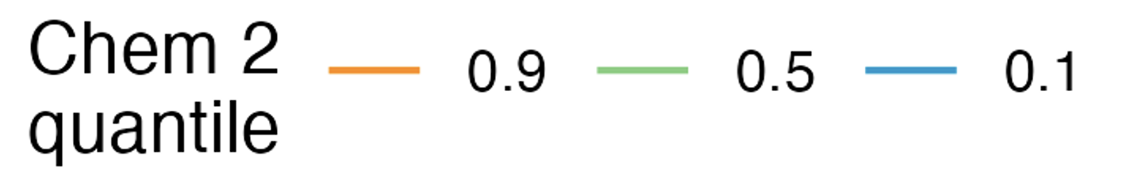
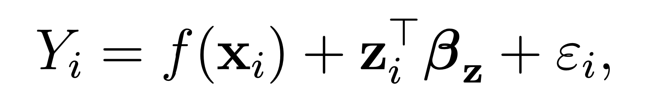
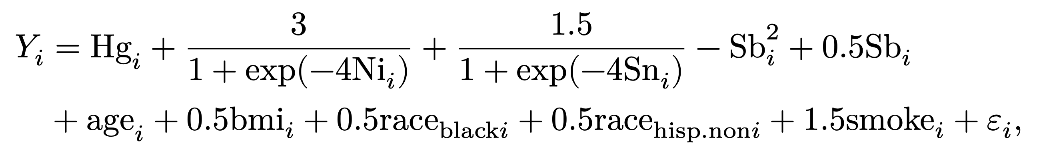
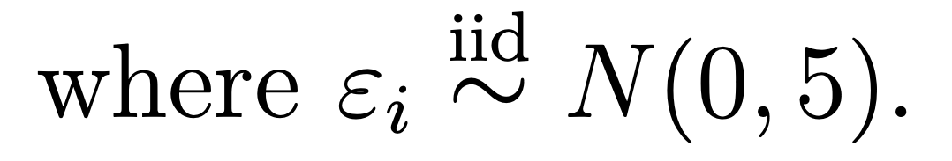
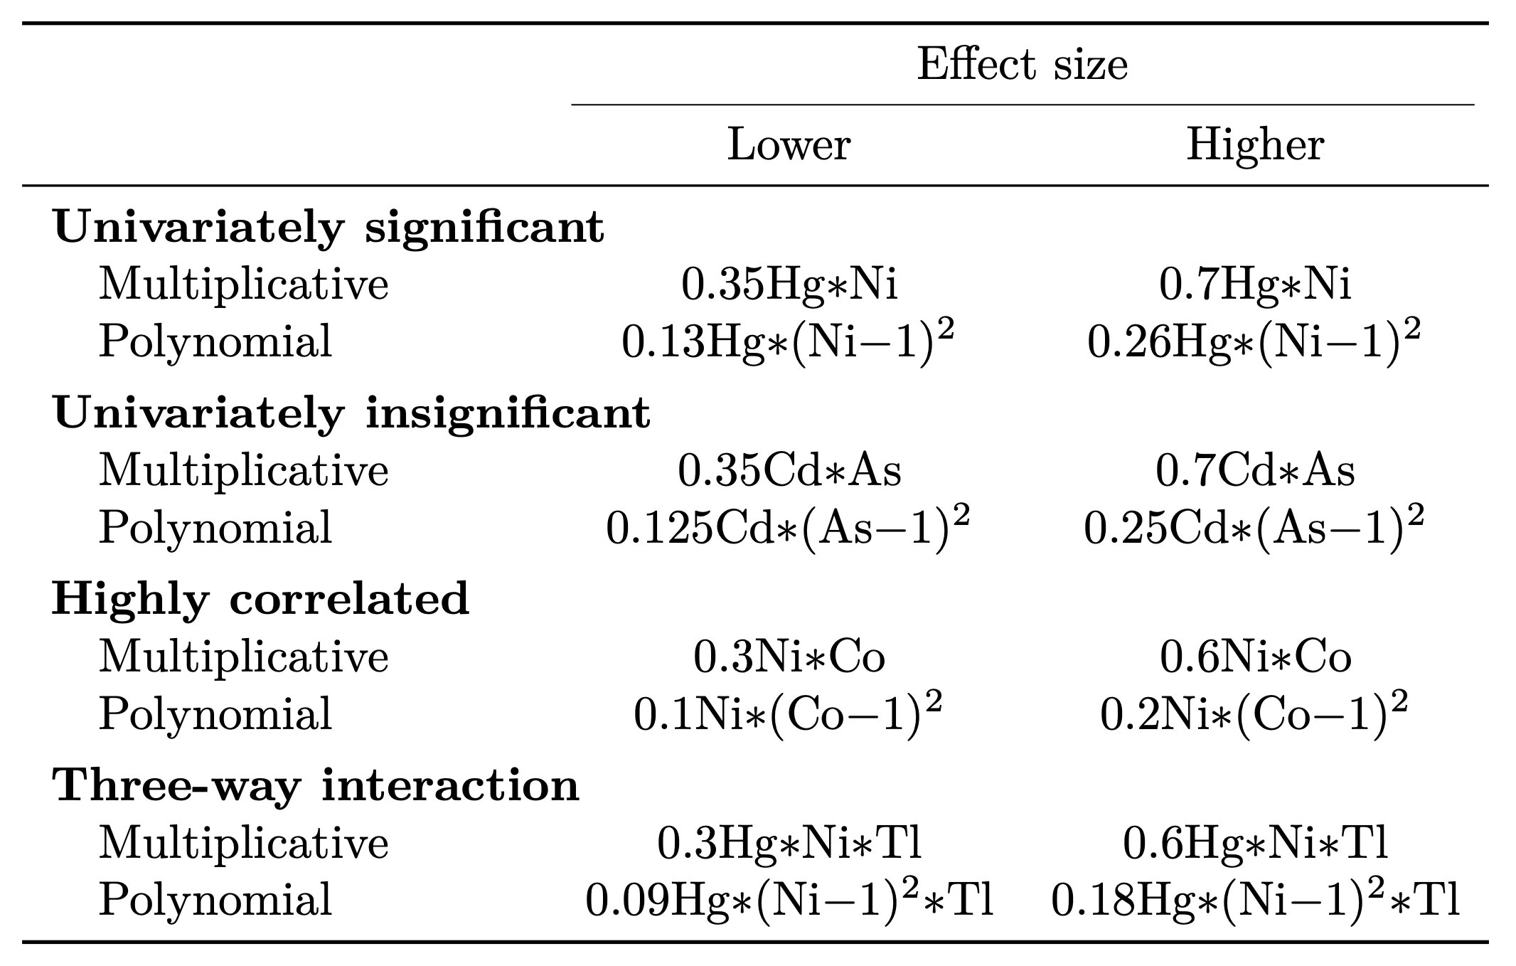
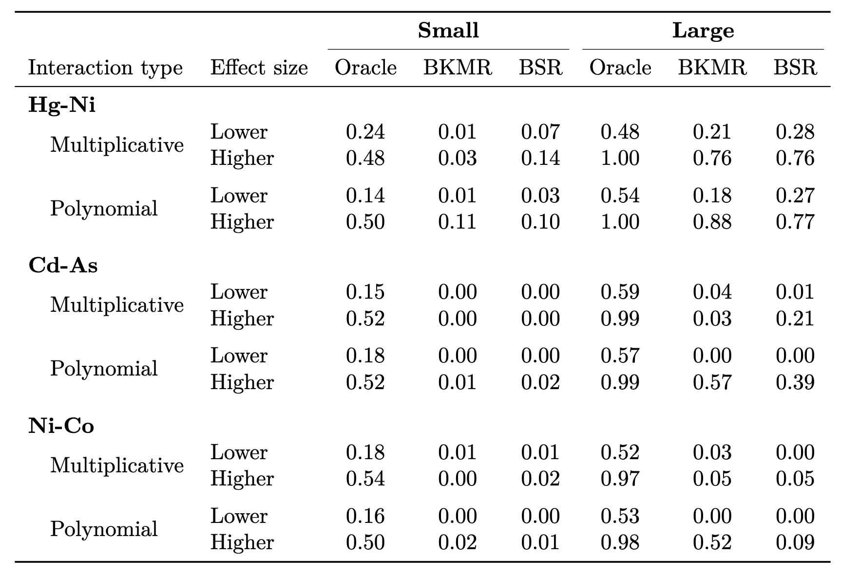
Flexible Bayesian regression models for interactions in exposure mixture studies
Elizabeth Zhang*, Advisor: Amy Wagaman
Amherst College, Department of Statistics; *Contact: eyzhang24@amherst.edu
Background
Simulated predictor data
For concision, only output from smaller datasets is included
Base case results
Three-way interactions
Table 3. Sensitivity to three-way interactions.
Figure 1. Daily average small particulate matter (PM2.5) concentration (μg/m³) in 2014.¹
Run-time analysis
Exposure mixtures: multiple co-occurring chemical pollutants
Identifying health effects of exposure mixtures can be more protective of human health
Non-additive interaction: the combined effect of 2+ variables ≠ the sum of their individual effects.
Interactions in exposure mixtures can lead to inaccurate estimates of risk if unaccounted for
Table 4. Mean run-time on high-performance computing cluster.
Figure 2. Correlation heat maps of exposures from observed data (a) and averaged from simulated data (b).
Figure 5. P-value distributions from smaller (a) and larger (b) size datasets and PIP distributions from smaller (c) and larger (d) size datasets. Naive multiple linear regressions (MLR) only contain univariate additive effects, and oracle MLRs contain the true specified relationships.
Figure 3. Distributions of log-transformed exposures from observed data (blue) and simulated data (gray).
Two-way interactions
Aim: Assess the ability of flexible Bayesian regression models to detect and characterize interactions in exposure mixture studies.
Implications
Figure 4. Distributions of continuous (a) and categorical (b) covariates from observed data (blue) and simulated data (gray).
Interactions are harder to detect…
in smaller sample sizes
between three or more chemicals, and
between univariate insignificant chemicals
Interaction PIPs from BSR can be used to quantify evidence of interactions from BKMR
Though BSR can be less sensitive than BKMR
Model formulations
Define Y_{i} as the health outcome, x_{i} as the exposures, z_{i}^{T}β_{z} as the effects of covariates, ε_{i} ̴ N(0 , σ²), iid.
Bayesian kernel machine regression (BKMR):²
Bayesian semiparametric regression (BSR):³
where h() is the Gaussian kernel, and f() is a linear combination of d-dimensional natural spline bases.
Generating the outcome
In the base case (all interactions are added onto this):
[1 base case + 4 interaction cases × 2 effect sizes × 2 functional forms] × 2 sample sizes = 34 scenarios
100x datasets per scenario → 3400 total datasets
Figure 6. Exposure-response relationships estimated by BKMR in small (a) and large (b) datasets and BSR in small (c) and large (d) datasets, using the first chemical fixed at quantiles of another to assess interactions between Hg and Ni. All other chemicals are fixed at 0.5 quantiles.
Next steps: assess interactions between race and exposures using stratified models
Acknowledgements
Thank you to Amy Wagaman for her invaluable support, Alex Keil for advice on the simulations, Shu-Min Liao for guidance on copulas, and Andy Anderson and Doug Hall for assistance with the cluster. Thank you to the Amherst College Department of Statistics for supporting this thesis.
References
Ritchie & Roser. Our World in Data, 2023.
Bobb et al. Biostatistics, 2015.
Antonelli et al. The Annals of Applied Statistics, 2020.
Howe et al. Environmental Health Perspectives, 2020.
Table 1. Specification of interaction terms.
Table 2. Sensitivity (p < 0.05 for Oracle MLR or PIP ≥ 0.5 for BKMR and BSR) to two-way interactions.
Methods
Use MADRES⁴ data to simulate data with interactions of different effect sizes and forms
Gaussian copulas to preserve marginal distributions and dependence structure
Size 252 (smaller) and 1000 (larger) datasets
Run linear regression, BKMR, and BSR
Default priors, 50,000 MCMC iterations
Compare sensitivity rate between methods
Abbreviations:
MADRES = Maternal And Developmental Risks from Environmental and Social Stressors, pregnancy cohort of predominantly Hispanic persons in Los Angeles, CA, 2015-2019;
MCMC = Markov chain Monte Carlo;
chemicals = arsenic (As), cadmium (Cd), cobalt (Co), mercury (Hg), nickel (Ni), molybdenum (Mo), lead (Pb), antimony (Sb), tin (Sn), and thallium (Tl);
PIP = posterior inclusion probability

